Slide 1







Notes:
“Enough is enough. I want to become a Data Scientist and this year I will work hard in order to become one,”
Well, We all thought this at the start of 2020, right?
Wow! This Immersive Bootcamp seems like the perfect opportunity for me to achieve that.
But then came COVID and these hopes were shattered.
Our Bootcamp was getting delayed and there seemed no way if we would be able to achieve what we wanted to.
Then the Bootcamp went Online and it’s been three months now.
The Physical Classroom experience would have been different. But that doesn’t mean that we are not learning enough right now.
In fact, E-learning has been a saviour!

Slide 2
Problem Statement

Slide 3






Course Sales

Slide 4
The Dataset

Slide 5
The Dataset
(512085 rows and 11 columns)
ID
Course_ID
Course_Domain
Long_Promotion
Day_No
Sales
Short_Promotion
Public_Holiday
User_Traffic
Competition_Metric
Course_Type

Slide 6

The Dataset
IDs range from 1 to 548027
Theses are not used in modelling, but we can know that there are some ID numbers in between that were not provided or recorded in the Train Dataset.
Our Test Dataset is taken from an original dataset of 548027 rows.
ID

Slide 7
The Dataset
Total of 600 courses are there.
They are labelled from 1 to 600.
Course_ID

Slide 8
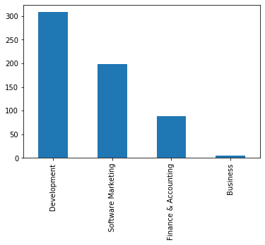
The Dataset
We have courses of Four domains- Development, Software Marketing, Finance and Accounting, Business.
More than half of our courses are about Development.
Course_Domain

Slide 9
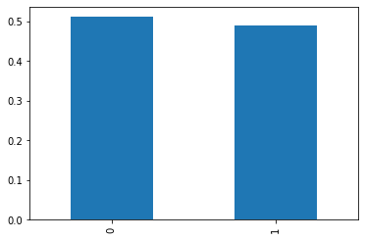
The Dataset
0 – Not on Long Promotion 1 – On Long Promotion
Half of our courses are on Long Promotion all the time, while Half of them are not.
Long_Promotion

Slide 10
The Dataset
For most of the courses, we had Data Available for 882 Days but for around 93 courses, we had Sales Data for just 698 Days.
There is a jump from 546 to 731 where no sales for these 93 courses were made, probably because they were taken down for maintenance, updation of content or any other reason.
Day_No

Slide 11
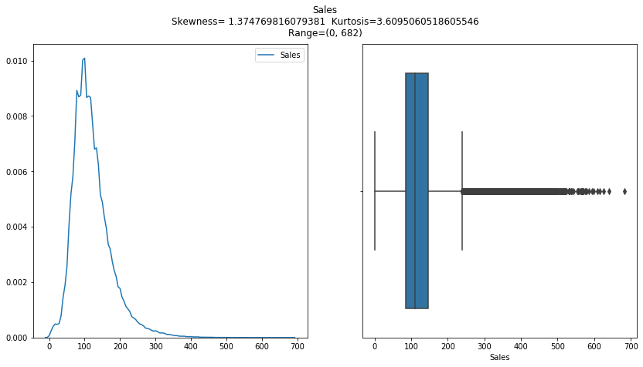
The Dataset
Average Sale Made per day is around 121.
Sales

Slide 12
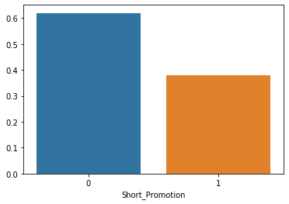
The Dataset
Around 38% of records are on Short Promotion.
Short_Promotion

Slide 13
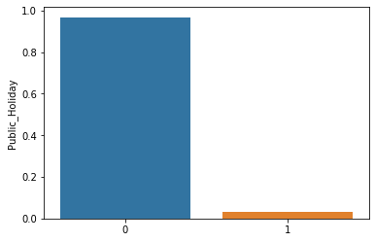
The Dataset
Only 25 out of a total of 882 days are Public Holidays.
Public_Holiday

Slide 14
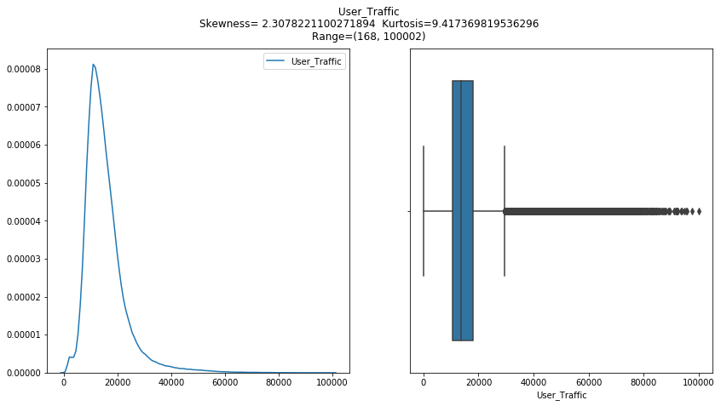
The Dataset
Around 15400 land on each course page per day.
User_Traffic

Slide 15
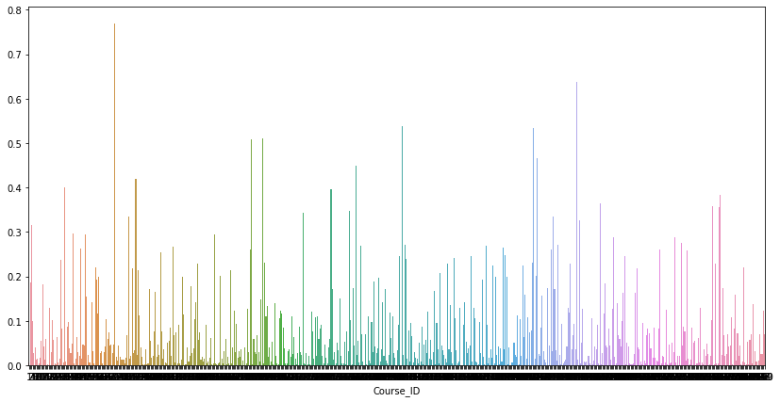
The Dataset
Mean of Competition_Metric is around 0.07.
Competition_Metric values for two courses is missing.
Competition_Metric

Slide 16
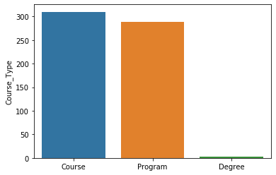
The Dataset
310 of 600 are Courses, 288 are Programmes while only 2 are Degree Programs.
Course_Type

Slide 17
Questions to be asked further

Slide 18
Questions to be asked further
Is Short Promotion causing an increase in Sales?
Do Public Holidays contribute to more Sales?
Do the courses which are being Long Promoted have Higher Sales?
Is User Traffic More on Public Holidays?
Does Higher User Traffic contributes to Higher Sales?
Do Courses with Higher Competition Metric have Lower Sales?
Does Course Type affect the Sale of a course?
Do Course Domains affect the Sales?
Do we observe any pattern of Sales wrt Day No?

Slide 19
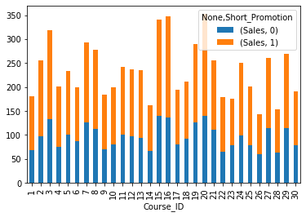
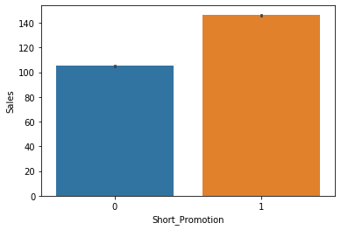
Is Short Promotion causing an increase in Sales?

Slide 20

Questions to be asked further
Is Short Promotion causing an increase in Sales?
Do Public Holidays contribute to more Sales?
Do the courses which are being Long Promoted have Higher Sales?
Is User Traffic More on Public Holidays?
Does Higher User Traffic contributes to Higher Sales?
Do Courses with Higher Competition Metric have Lower Sales?
Does Course Type affect the Sale of a course?
Do Course Domains affect the Sales?
Do we observe any pattern of Sales wrt Day No?

Slide 21
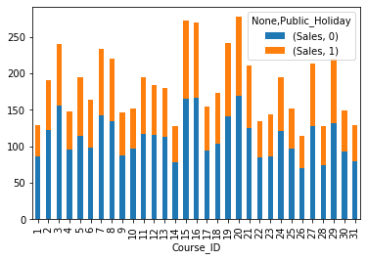
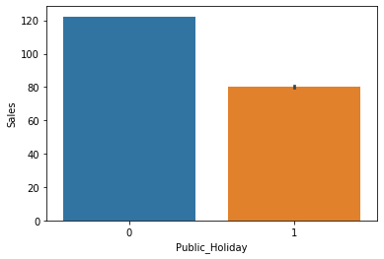
Do Public Holidays contribute to more Sales?

Slide 22
Questions to be asked further
Is Short Promotion causing an increase in Sales?
Do Public Holidays contribute to more Sales?
Do the courses which are being Long Promoted have Higher Sales?
Is User Traffic More on Public Holidays?
Does Higher User Traffic contributes to Higher Sales?
Do Courses with Higher Competition Metric have Lower Sales?
Does Course Type affect the Sale of a course?
Do Course Domains affect the Sales?
Do we observe any pattern of Sales wrt Day No?

Slide 23
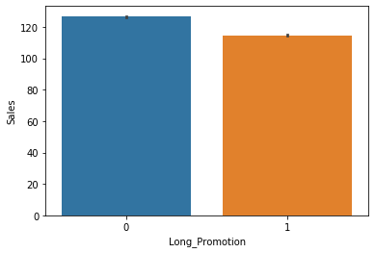

Do the courses which are being Long Promoted have Higher Sales?

Slide 24
Questions to be asked further
Is Short Promotion causing an increase in Sales?
Do Public Holidays contribute to more Sales?
Do the courses which are being Long Promoted have Higher Sales?
Is User Traffic More on Public Holidays?
Does Higher User Traffic contributes to Higher Sales?
Do Courses with Higher Competition Metric have Lower Sales?
Does Course Type affect the Sale of a course?
Do Course Domains affect the Sales?
Do we observe any pattern of Sales wrt Day No?

Slide 25
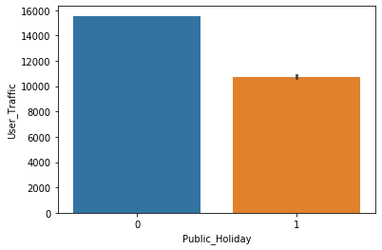

Is User Traffic More on Public Holidays?

Slide 26
Questions to be asked further
Is Short Promotion causing an increase in Sales?
Do Public Holidays contribute to more Sales?
Do the courses which are being Long Promoted have Higher Sales?
Is User Traffic More on Public Holidays?
Does Higher User Traffic contributes to Higher Sales?
Do Courses with Higher Competition Metric have Lower Sales?
Does Course Type affect the Sale of a course?
Do Course Domains affect the Sales?
Do we observe any pattern of Sales wrt Day No?

Slide 27
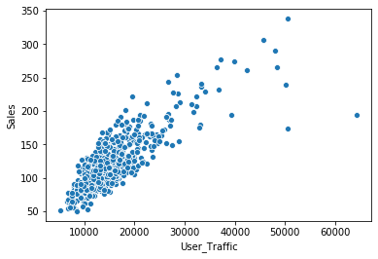

Does Higher User Traffic contributes to Higher Sales?

Slide 28
Questions to be asked further
Is Short Promotion causing an increase in Sales?
Do Public Holidays contribute to more Sales?
Do the courses which are being Long Promoted have Higher Sales?
Is User Traffic More on Public Holidays?
Does Higher User Traffic contributes to Higher Sales?
Do Courses with Higher Competition Metric have Lower Sales?
Does Course Type affect the Sale of a course?
Do Course Domains affect the Sales?
Do we observe any pattern of Sales wrt Day No?

Slide 29
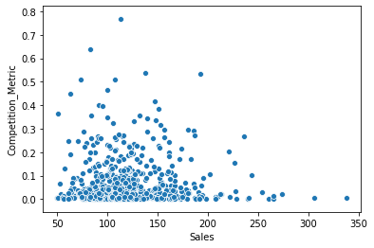

Do Courses with Higher Competition Metric have Lower Sales?

Slide 30
Questions to be asked further
Is Short Promotion causing an increase in Sales?
Do Public Holidays contribute to more Sales?
Do the courses which are being Long Promoted have Higher Sales?
Is User Traffic More on Public Holidays?
Does Higher User Traffic contributes to Higher Sales?
Do Courses with Higher Competition Metric have Lower Sales?
Does Course Type affect the Sale of a course?
Do Course Domains affect the Sales?
Do we observe any pattern of Sales wrt Day No?

Slide 31
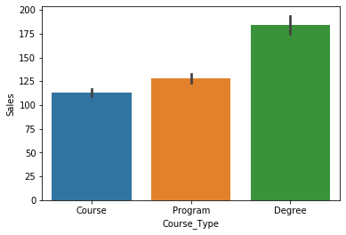

Does Course Type affect the Sale of a course?

Slide 32
Questions to be asked further
Is Short Promotion causing an increase in Sales?
Do Public Holidays contribute to more Sales?
Do the courses which are being Long Promoted have Higher Sales?
Is User Traffic More on Public Holidays?
Does Higher User Traffic contributes to Higher Sales?
Do Courses with Higher Competition Metric have Lower Sales?
Does Course Type affect the Sale of a course?
Do Course Domains affect the Sales?
Do we observe any pattern of Sales wrt Day No?

Slide 33
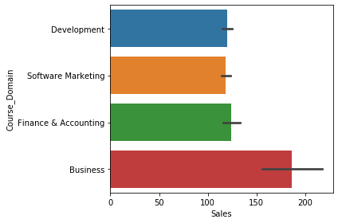

Do Course Domains affect the Sales?

Slide 34
Questions to be asked further
Is Short Promotion causing an increase in Sales?
Do Public Holidays contribute to more Sales?
Do the courses which are being Long Promoted have Higher Sales?
Is User Traffic More on Public Holidays?
Does Higher User Traffic contributes to Higher Sales?
Do Courses with Higher Competition Metric have Lower Sales?
Does Course Type affect the Sale of a course?
Do Course Domains affect the Sales?
Do we observe any pattern of Sales wrt Day No.?

Slide 35
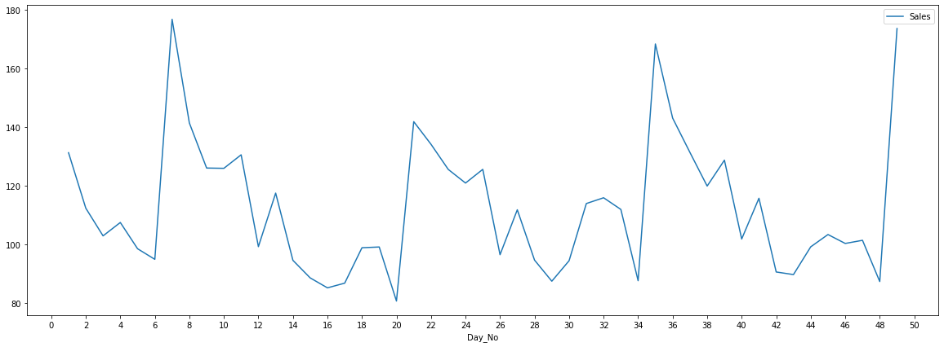
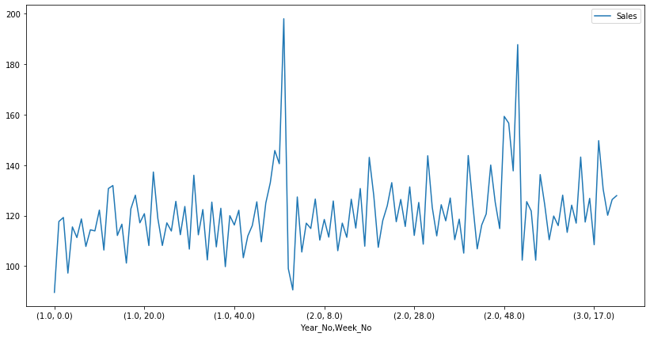
Do we observe any pattern of Sales wrt Day No.?

Slide 36
Features Engineered

Slide 37
Features Engineered
Week_No
Year_No
Day_of_2_Weeks
Target_Course_ID
Group_Traffic

Slide 38
Models

Slide 39
Models
Model | 1000*RMSLE (Public)
1. Grouped Mean Model by Course_ID, Week_No and Short_Promo | 188.23
2. Linear Regression | 196.67
3. Decision Tree | 164.67
4. XGBoost | 143.62
5. LightGBM | 149.77
6. CatBoost | 151.56

Slide 40
Conclusion

Slide 41
Conclusion – What more could have been done?
Further tuning of the Boosting Models
Ensembling few of the models made
Creating more features

Slide 42


